Slide 1
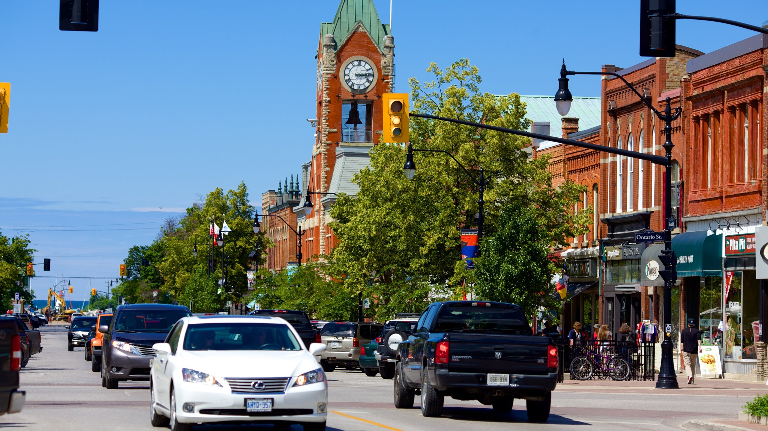

Master Mobility and Transportation Plan: Community Stakeholder Engagement Session #1
March 2024

Slide 2
Master Mobility and Transportation Plan
Community Stakeholder Engagement Session #1
Master Mobility and Transportation Plan (MMTP)
What is it?
A long-term plan to develop a transportation network to accommodate growth.
The MMTP will integrate existing and future land-use planning and the planning of transportation infrastructure, while considering mobility and active transportation in the process.
Why do we need a MMTP?
To accommodate the impact of growth and travel patterns to 2051.
To provide the Town with long-range planning necessary to identify needs, establish priorities between vehicles, active transportation modes (e.g., cycling, trails), mobility, and transit.
To review best practices on emerging transportation trends and movement of goods.

Slide 3

Master Mobility and Transportation Plan
Community Stakeholder Engagement Session #1
Master Planning Process
MMTP will follow Approach #1 of the Master Planning Process in the Municipal Class Environmental Assessment (MCEA) document (March 2023).
In line with the MCEA (2023) guidance, Master Plans must satisfy the first two (2) phases of the Class EA process:
- Phase 1: Problem or Opportunity
- Phase 2: Alternative Solutions
Phases 1 and 2 will generally be addressed and form the basis for the recommended Schedule ‘B’ and ‘C’ transportation infrastructure projects.

Slide 4
Master Mobility and Transportation Plan
Community Stakeholder Engagement Session #1
Timeline
Event | Proposed Dates
Notice of Study Commencement | January 10, 2024
Online Survey | January 12 – January 31, 2024
Technical Stakeholder Engagement Session #1 (online session) | March 7, 2024
Community Stakeholder Engagement Session #1 (Workshop) | March 5, 2024
Public Information Centre #1 | March 25, 2024
Council Review | April 22, 2024
Technical Stakeholder Engagement Session #2 (online session) | June 2024
Community Stakeholder Session #2 (Workshop) | August 2024
Notice of PIC #2 | Late October - November 2024
Technical Stakeholder Engagement Session #3 (online session) | November 2024
Council Review | November 2024
Public Information Centre #2 | November 2024
Technical Stakeholder Engagement Session #4 (online session) | January 2025
Council Review | January 2025
Notice of Completion of MMTP | January-February 2025
We are here

Slide 5

Master Mobility and Transportation Plan
Community Stakeholder Engagement Session #1
Aligning with Local and County Policy
Town of Collingwood Official Plan (December 2023)
Tailored for increased traffic volumes anticipated within Collingwood and the surrounding area to the year 2051.
Create a safe, multi-modal and integrated transportation system in co-operation with the Town’s neighbouring municipalities.
Enhance public transit systems (both County and Town).
Focus on creating and enhancing a connected network of Active Transportation facilities to serve Collingwood and connect communities.
Safely facilitate movement of through-traffic to recreational and resort areas.

Slide 6
Master Mobility and Transportation Plan
Community Stakeholder Engagement Session #1
Aligning with Local and County Policy
Town of Collingwood Economic Development Action Plan (2020 – 2025)
Emphasized the need for better public transportation, regional transportation, and transport to the GTA.
Expanding the range of affordable transit, as well as cycling and shared-economy transportation options, is vital in promoting Collingwood as a great place to live and work.
County of Simcoe Transportation Master Plan (TMP) Update (November 2023)
The TMP Update serves as a roadmap for investing in roads, transit, walking and cycling to the planning horizon of 2051 and beyond.
Needs and Opportunities include:
Roads: address capacity constraints and integrate all travel modes through a Complete Streets approach.
Cycling: elevate the role of active transportation to respond to a growing demand for safe, dedicated cycling routes.
Transit: grow County transit connections, coverage, accessibility, integration and rider experience to respond to growth and support mode share uptake.
Strategies: develop supporting strategies and polices to achieve Goals of the TMP.

Slide 7
Master Mobility and Transportation Plan
Community Stakeholder Engagement Session #1
Aligning with Local and County Policy
The Town of Blue Mountains TMP (December 2023)
Reviewed three (3) alternatives:
Maintain Existing Infrastructure/Do Nothing;
Invest in Active Transportation and Transit (Near Term); and,
Highway 26 Alternative Route & Investment in Active Transportation and Transit (Best Option)
Recommendations for transit included: pilot 30-minutes headway of Blue Mountain Link & partner with Colltrans to explore expansion of their on-demand service.
Recommended Active Transportation links to Collingwood, safety improvements to adjacent roads and in coordination with South Georgian Bay municipalities
Request MTO to advance a regional Highway 26 Transportation study with consideration for measures shown in the TMP.

Slide 8
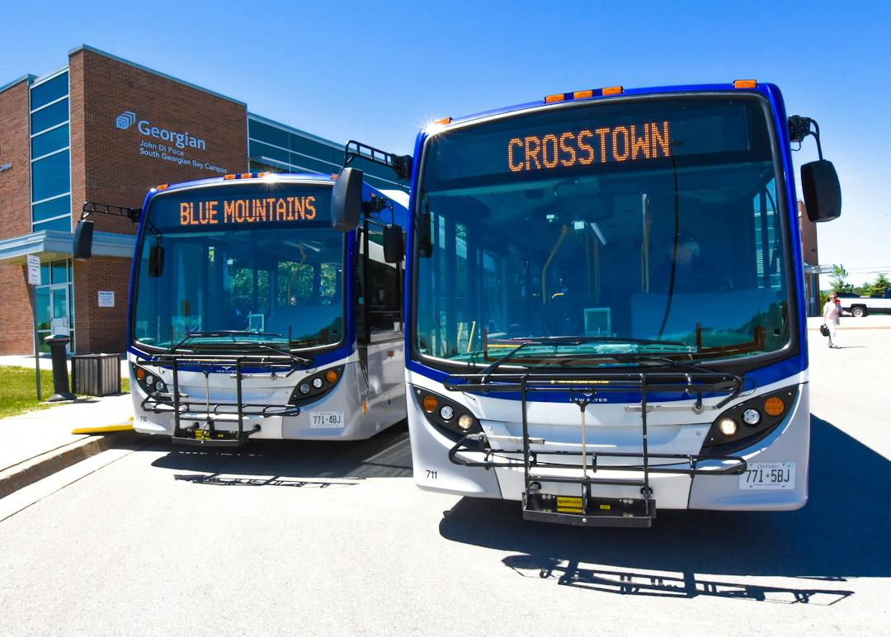
Master Mobility and Transportation Plan
Community Stakeholder Engagement Session #1
Town’s Policy Direction
Enhancing Active Transportation facilities within Collingwood and in surrounding municipalities.
To build upon the Town’s and County’s public transit system through connectiveness, accessibility and affordability.
Address capacity constraints on roads due to anticipated traffic volume increase to the year 2051.
Create a safe, multi-modal and integrated transportation system.

Slide 9
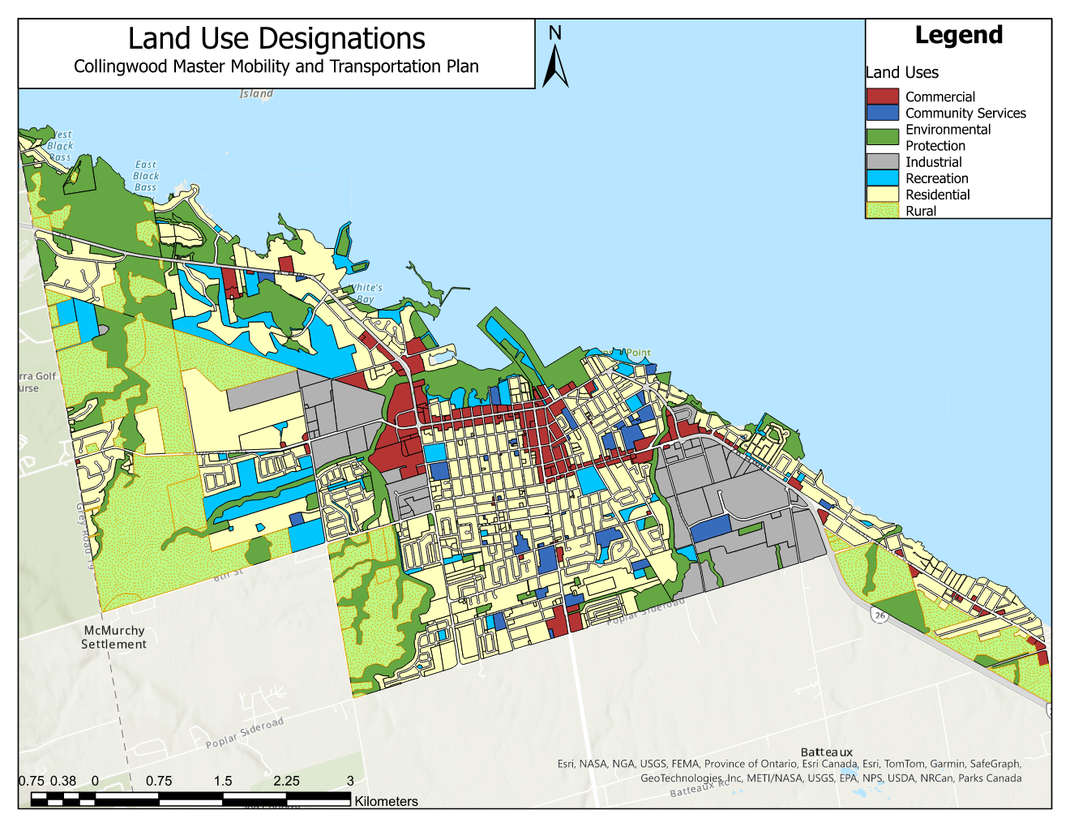

Master Mobility and Transportation Plan
Community Stakeholder Engagement Session #1
Urban Structure & Land Use Characteristics
Due to an increased influx of residents to Collingwood, Strategic Growth Areas have been determined to accommodate new residential and future communities, within the existing urban and rural landscape.

Slide 10
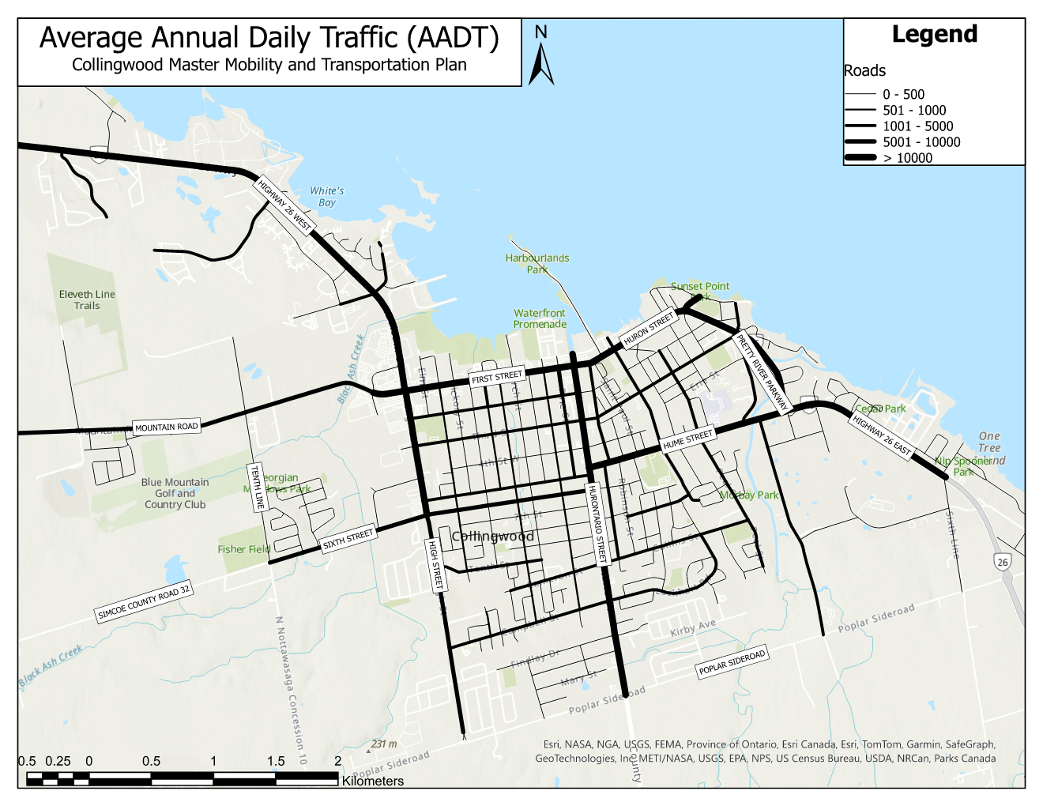
Master Mobility and Transportation Plan
Community Stakeholder Engagement Session #1
Existing Road Network
Main Arterials with High AADT
Highway 26
Pretty River Parkway
Mountain Road
Hume Street
Huron Street
High Street
First Street
Sixth Street

Slide 11
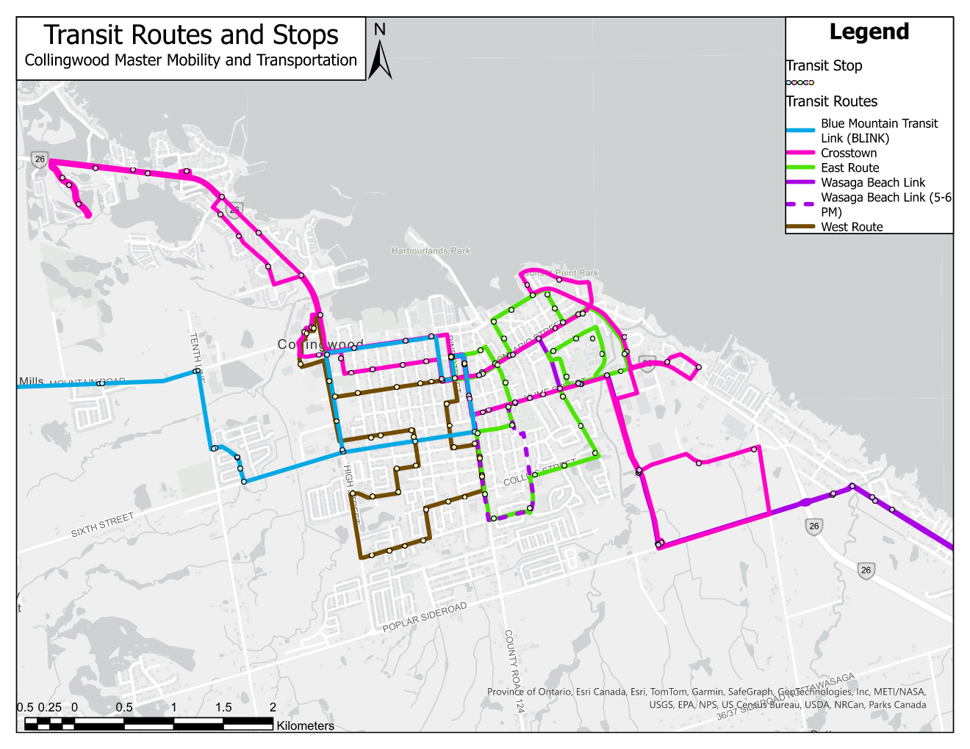
Master Mobility and Transportation Plan
Community Stakeholder Engagement Session #1
Existing Transit Network
Transit Route Operators
Colltrans (Crosstown, East Route, & West Route)
Blue Mountain Link (BLINK)
Simcoe County LINX Transit Service (Wasaga Beach Link)
Future goals to strengthen Collingwood’s existing transit network include:
Exploring route opportunities to maximize service connectivity and frequency
Integrating service fares to secure direct connections between nearby municipalities

Slide 12
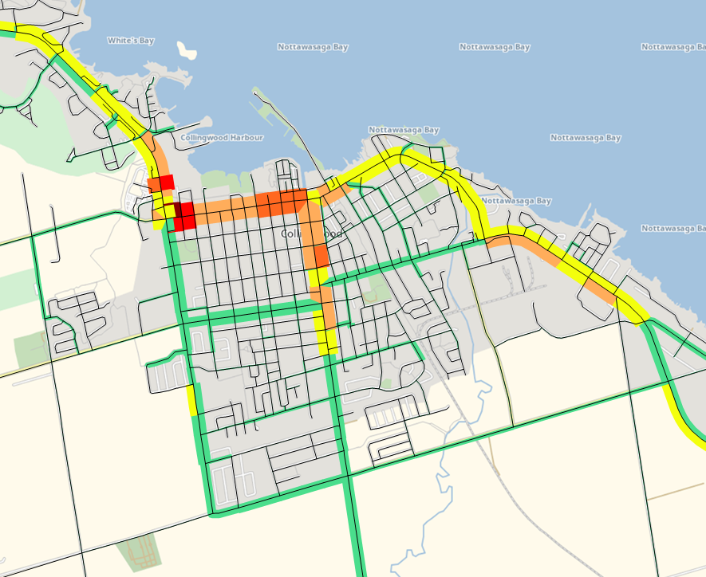
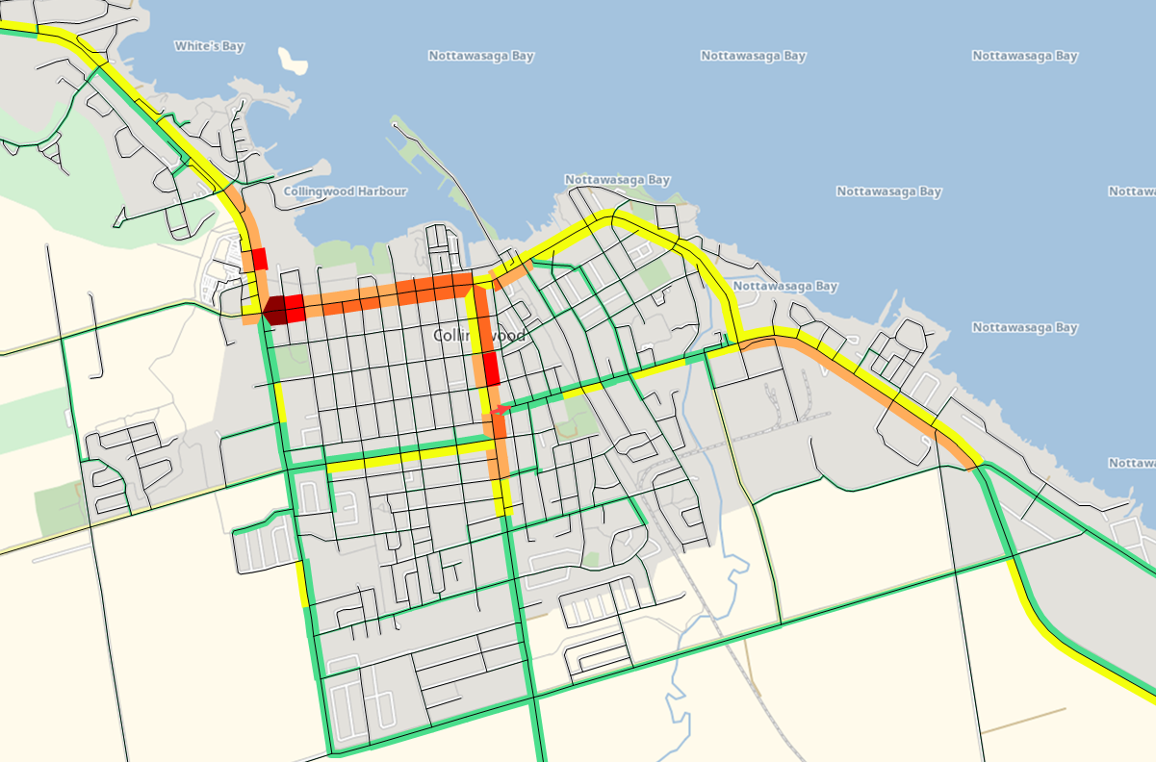
Master Mobility and Transportation Plan
Community Stakeholder Engagement Session #1
Existing Roadway Capacity Conditions
Legend
LOS A 0.00 – 0.51
LOS B 0.51 – 0.70
LOS C 0.71 – 0.80
LOS D 0.81 – 0.90
LOS E 0.91 – 0.99
LOS F 1.00 +
Weekend Peak Hour (Summer)
Weekday Peak Hour (Summer)
Notes:
Ideally, a single traffic lane can accommodate between 1800 to 2000 vehicles per hour per lane (vphpl).
However, a capacity of 1800 to 2000 vphpl is not realistic on the Town roads due to the effects of adjacent signals and intersection controls, road grade, lane width, vehicle composition (ie. number of trucks), obstructions and access, and road function.

Slide 13
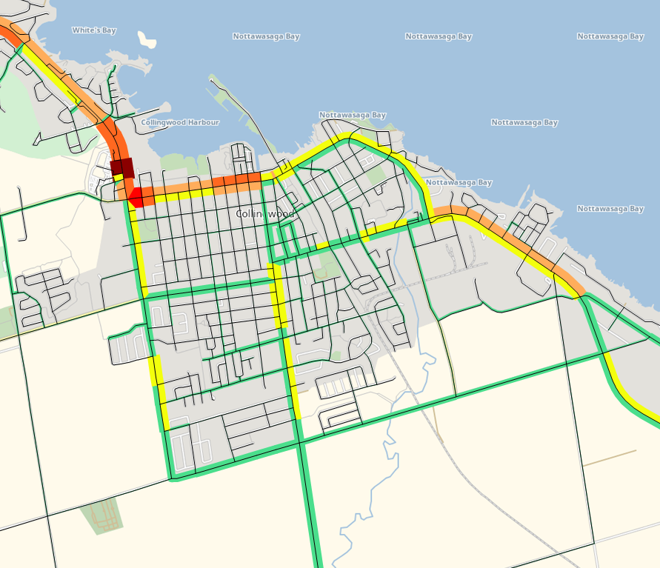
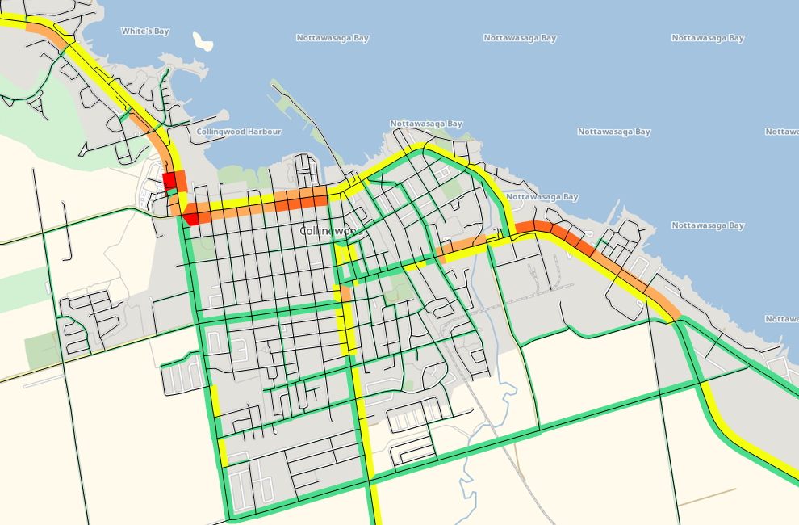
Master Mobility and Transportation Plan
community Stakeholder Engagement Session #1
Existing Road Network Capacity Conditions
Legend
LOS A 0.00 – 0.51
LOS B 0.51 – 0.70
LOS C 0.71 – 0.80
LOS D 0.81 – 0.90
LOS E 0.91 – 0.99
LOS F 1.00 +
Weekend Peak Hour (Winter)
Weekday Peak Hour (Winter)
Notes:
Ideally, a single traffic lane can accommodate between 1800 to 2000 vehicles per hour per lane (vphpl).
However, a capacity of 1800 to 2000 vphpl is not realistic on the Town roads due to the effects of adjacent signals and intersection controls, road grade, lane width, vehicle composition (ie. number of trucks), obstructions and access, and road function.

Slide 14
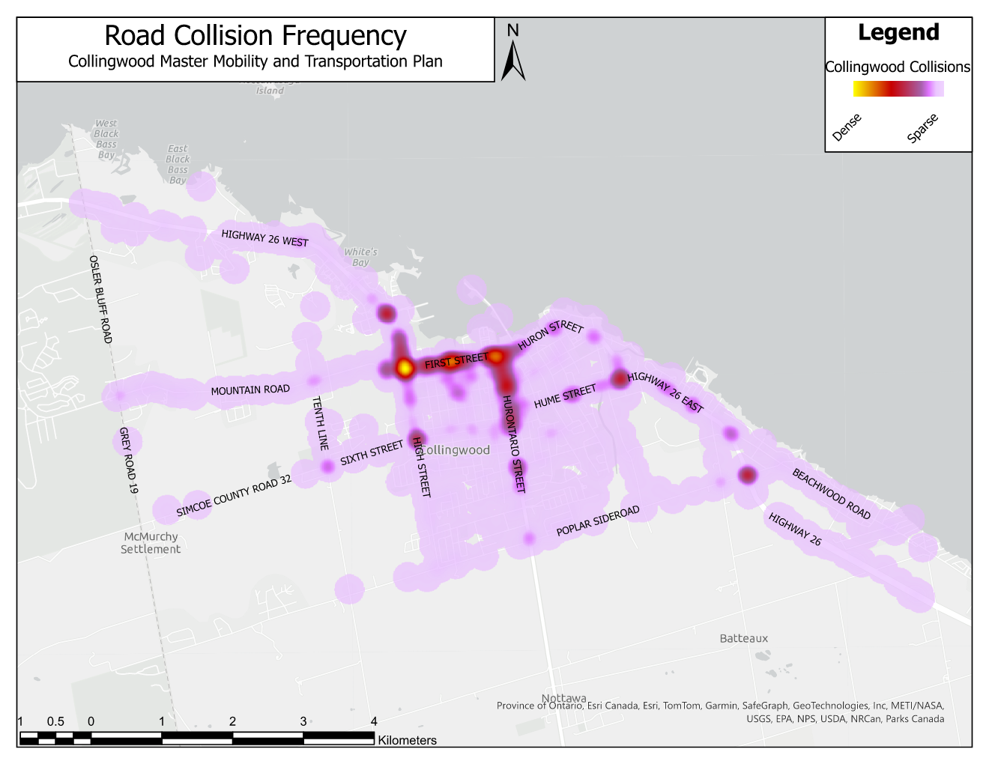
Master Mobility and Transportation Plan
Community Stakeholder Engagement Session #1
Existing Traffic Safety Conditions

Slide 15
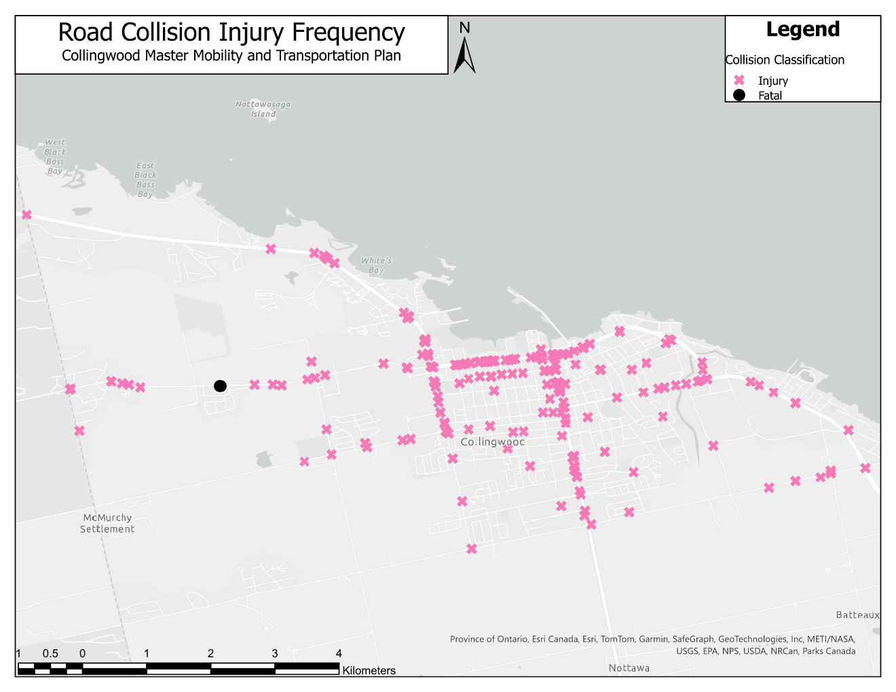
Master Mobility and Transportation Plan
Community Stakeholder Engagement Session #1
Existing Traffic Safety Conditions
Data between the start of 2017 till August 2023

Slide 16
Master Mobility and Transportation Plan
Community Stakeholder Engagement Session #1
Existing Traffic Safety Conditions
Collisions Review
Six and 2/3 years (2017 to Aug. 2023) analysis.​
1,638 collisions*​. Frequency of approximately 245.7 collisions per year within the Town.
82% of collisions occurred during daylight.
78% of collisions occurred during clear weather.
54% of collisions were intersection related.​
Most frequent times of year for collisions is in the Winter (Nov. to Feb.) and Summer (Jul. & Aug.) months.
*Collisions classified as occurring in a parking lot, off-highway, and on a frozen lake or river were not included in the analysis. These total 699 collisions.

Slide 17




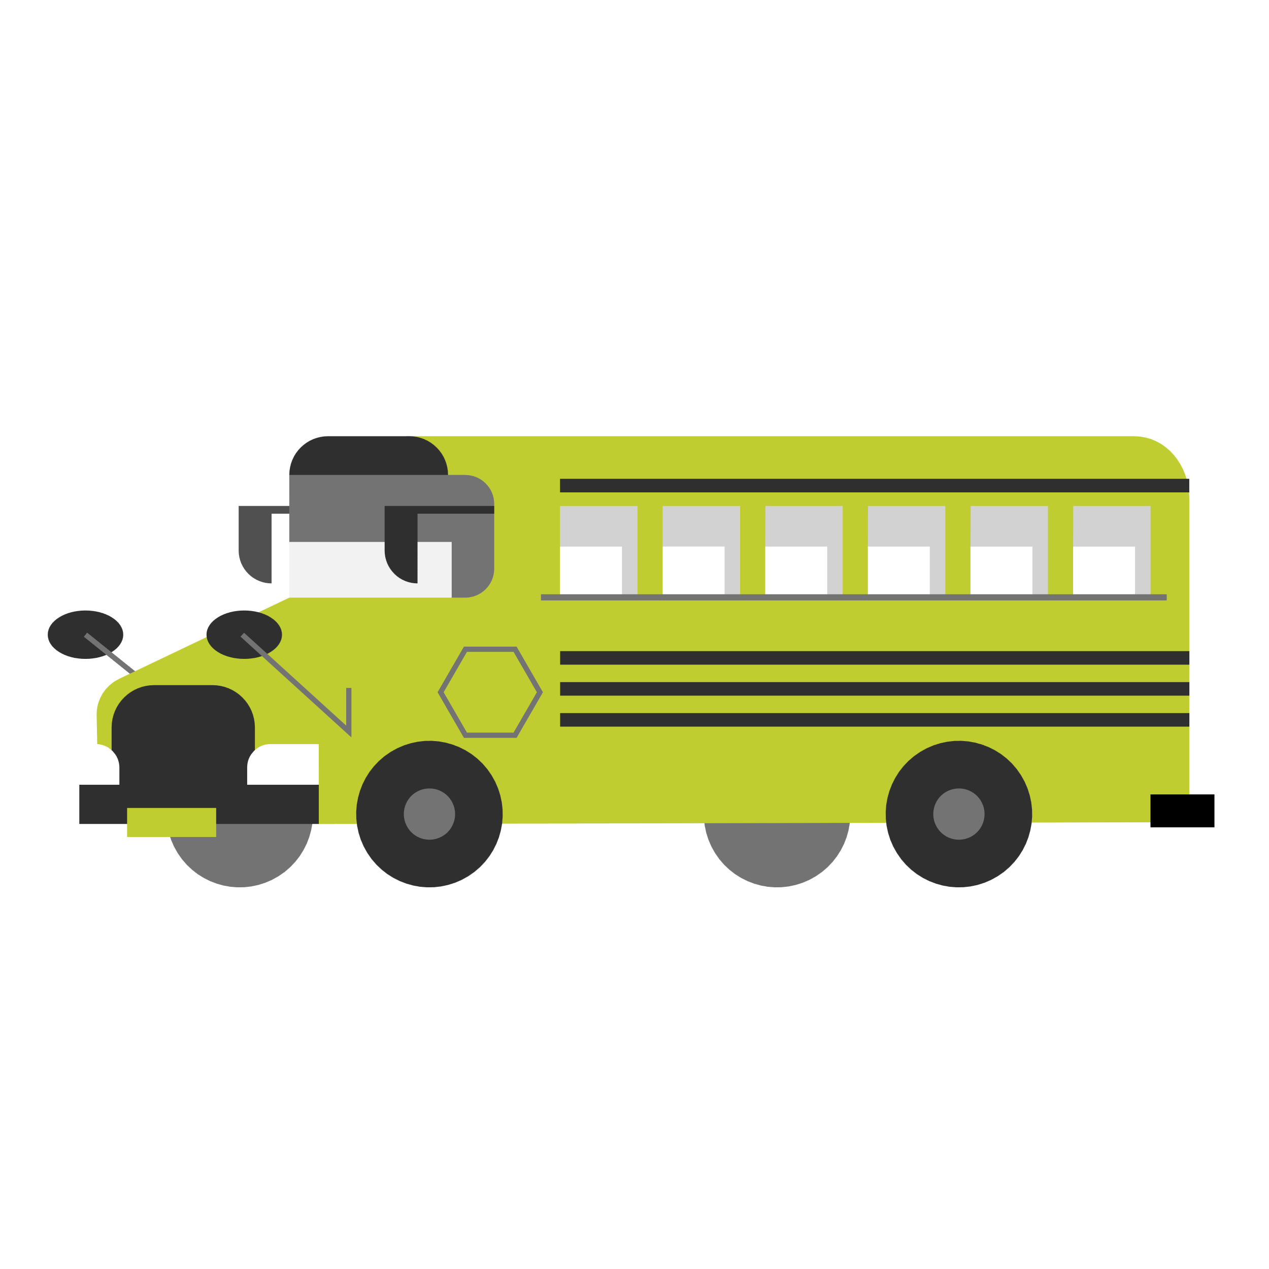
Master Mobility and Transportation Plan
Community Stakeholder Engagement Session #1
Existing Multi-Modal Split
Current Modes
Cycling and Walking trips primarily begin and end within the Town.
69% of transit trips begin or end outside of the Town.
All paid rideshare trips either begin or end outside of the Town.
Walking
Cycling
Transit
Rideshare
School Bus
*Multi-Modal Analysis conducted using 2016 Transportation Tomorrow Survey (TTS) for the PM Peak Period (3PM-7PM)

Slide 18
Master Mobility and Transportation Plan
Community Stakeholder Engagement Session #1
Survey Response
A public survey was provided on the https://engage.collingwood.ca/mmtp website between January 12th and January 31st with 551 responses received.
A summary of the responses are provided below and on the following slides:
70% of respondents were from the “Central Area of Collingwood: North of Poplar Sideroad, East of High Street and West of Raglan Street.”
72% of respondents were aged 46 and above, with 39.2% in the 46-65 age group (largest group).

Slide 19
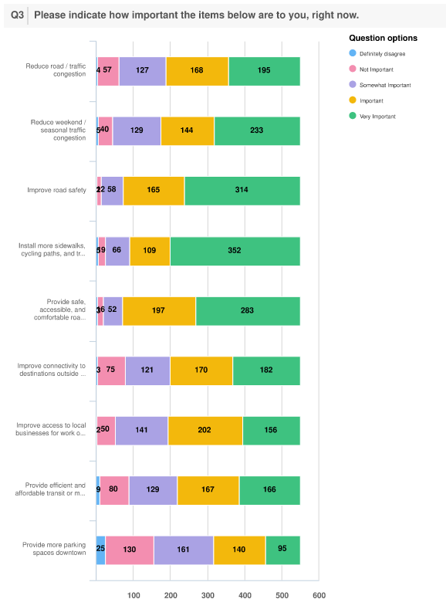
Master Mobility and Transportation Plan
Community Stakeholder Engagement Session #1
Survey Response
Very Important
Installation of more sidewalks, cycling paths and trails;
Improving road safety;
Safe, accessible, and comfortable roads for all road users;
Reducing weekend/seasonal traffic was seen as important;
Reducing road/traffic congestion;
Improving connectivity to outside Town;
Provide efficient and affordable transit or micro transit services;
Improve access to local businesses for work or shopping; and,
Provision of parking downtown was perceived as the least important.
Least Important

Slide 20
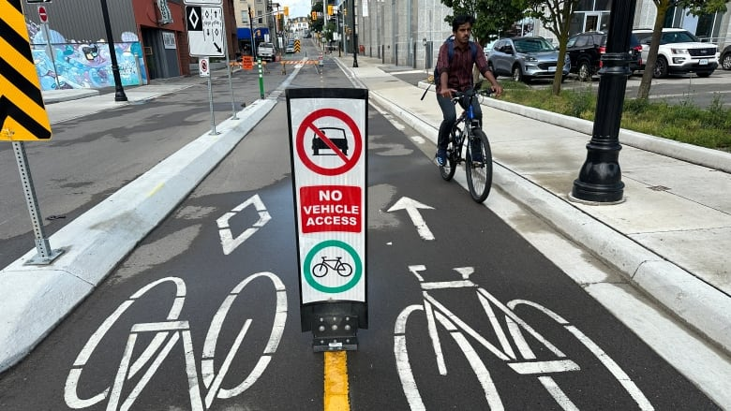
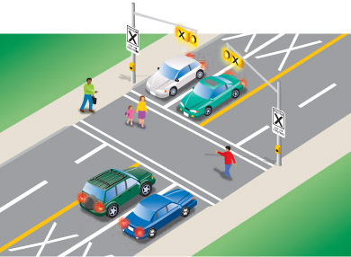
Master Mobility and Transportation Plan
Community Stakeholder Engagement Session #1
Survey Response – Cycling / Walking
Majority of respondents walked or cycled a few times per week or daily for recreational trips (67%).
When asked if the Town provided additional safe, accessible infrastructure, 80% of respondents said they would walk or cycle more.
Comments received had priority given for sidewalks in residential areas, schools and shopping areas.
A lesser number of respondents noted they walked or cycled to school or work; likely due to the demographics of the survey with 32.8% of respondents over age of 65.

Slide 21
Master Mobility and Transportation Plan
Community Stakeholder Engagement Session #1
Survey Response - Transit
71% of respondents noted they never used transit and 22.5% said rarely.
Of those who used public transit, the majority thought the services in Collingwood were either somewhat sufficient (35.2%), sufficient (25.8%), or more than sufficient (4.2%).
Comments received with regards to transit included:
Smaller buses were required and an increase in bus stops;
Expand service areas in residential areas (routes were perceived as old and based on previous development); need to incorporate routes in east side of Town;
Better connection east-west and downtown to Blue Mountain Village;
Shorter more direct bus routes and increased frequency;
Some respondents noted on-demand does not work well (i.e. slow, no guarantees, better scheduling) but many wanted on-demand to continue;
Extend hours (5 am to 11 pm) to capture workers in tourist trades;
Direct connections to Barrie Go Train, Toronto, Wasaga Beach and Blue Mountain; and,
Better signage for transit routes.

Slide 22
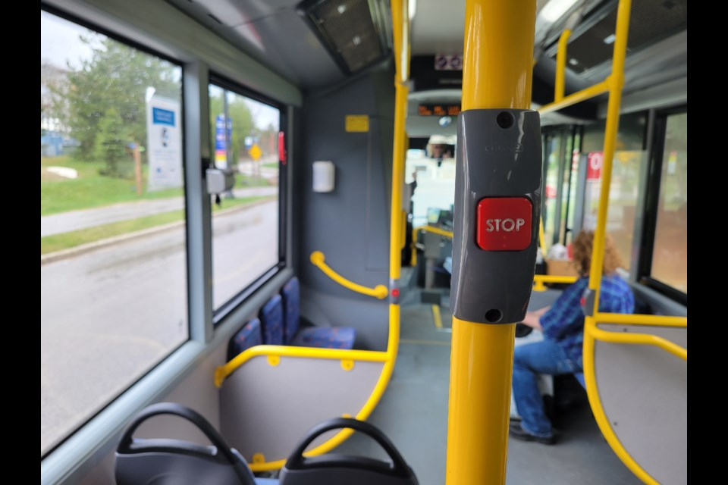
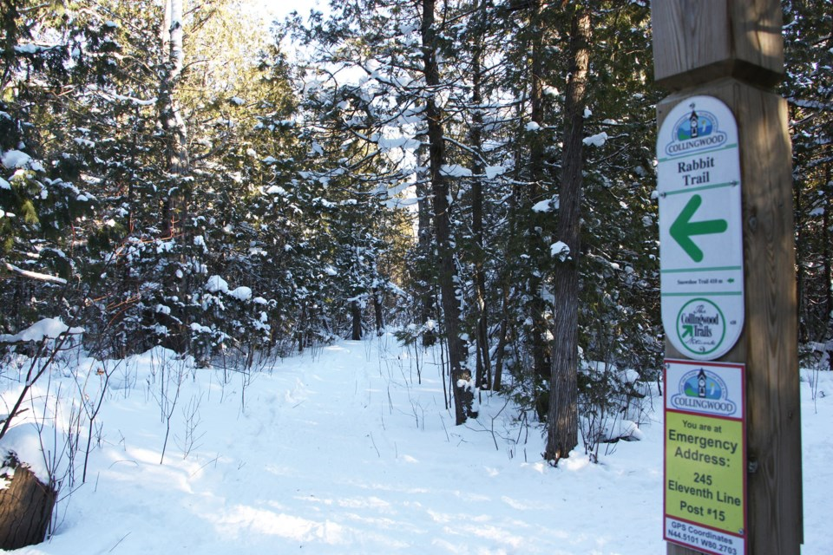
Master Mobility and Transportation Plan
Community Stakeholder Engagement Session #1
Survey Response – Other Comments
Reduce speed limits coming into Town and on Highway 26;
Better parking in downtown;
Improve active transportation in downtown;
Better signage for trails;
More bike lanes and bike paths beside roads;
Separate walking and cycling (not multi-use);
Address moving in winter;
Complete connectivity of trails, neighbourhoods and clean up transitions from trails to roads; and
Mountain Road should be divided (4 lanes).

Slide 23
Master Mobility and Transportation Plan
Community Stakeholder Engagement Session #1
Discussion Points
Cycling (i.e. segregated bike lanes)
Walking (i.e. multi use trails)
Active Transportation & Connected Network
Improved Transit (Town & County)
Transportation Safety
Alleviate Congestion Issues (i.e. particular areas / streets)
Trail and Transit Connectivity (i.e. between adjacent municipalities and within Town)
Parking (i.e. improve existing)

Slide 24
Master Mobility and Transportation Plan
Community Stakeholder Engagement Session #1
Next Steps
Review comments from both Community and Technical Stakeholder Engagement Sessions.
Hold Public Information Centre #1 (late March 2024).
Traffic Modeling and Issues / Opportunities Identification (May – July 2024).
Community Stakeholder Engagement Session #2 (August 2024).

Slide 25
Master Mobility and Transportation Plan
Community Stakeholder Engagement Session #1
We Welcome Your Comments
Please visit the Engage Collingwood website for project updates and more information:
https://engage.collingwood.ca/mmtp
Please find below the following contacts for the project:
Town of Collingwood Project Manager EXP Project Manager
Ed Dujlovic, P.Eng. Yves-Marie Monereau, P.Eng., PE, PTOE, RSP
Project Manager Manager, Traffic Engineering
Email: edujlovic@collingwood.ca Email: Yves-Marie.Monereau@exp.com

