Slide 1
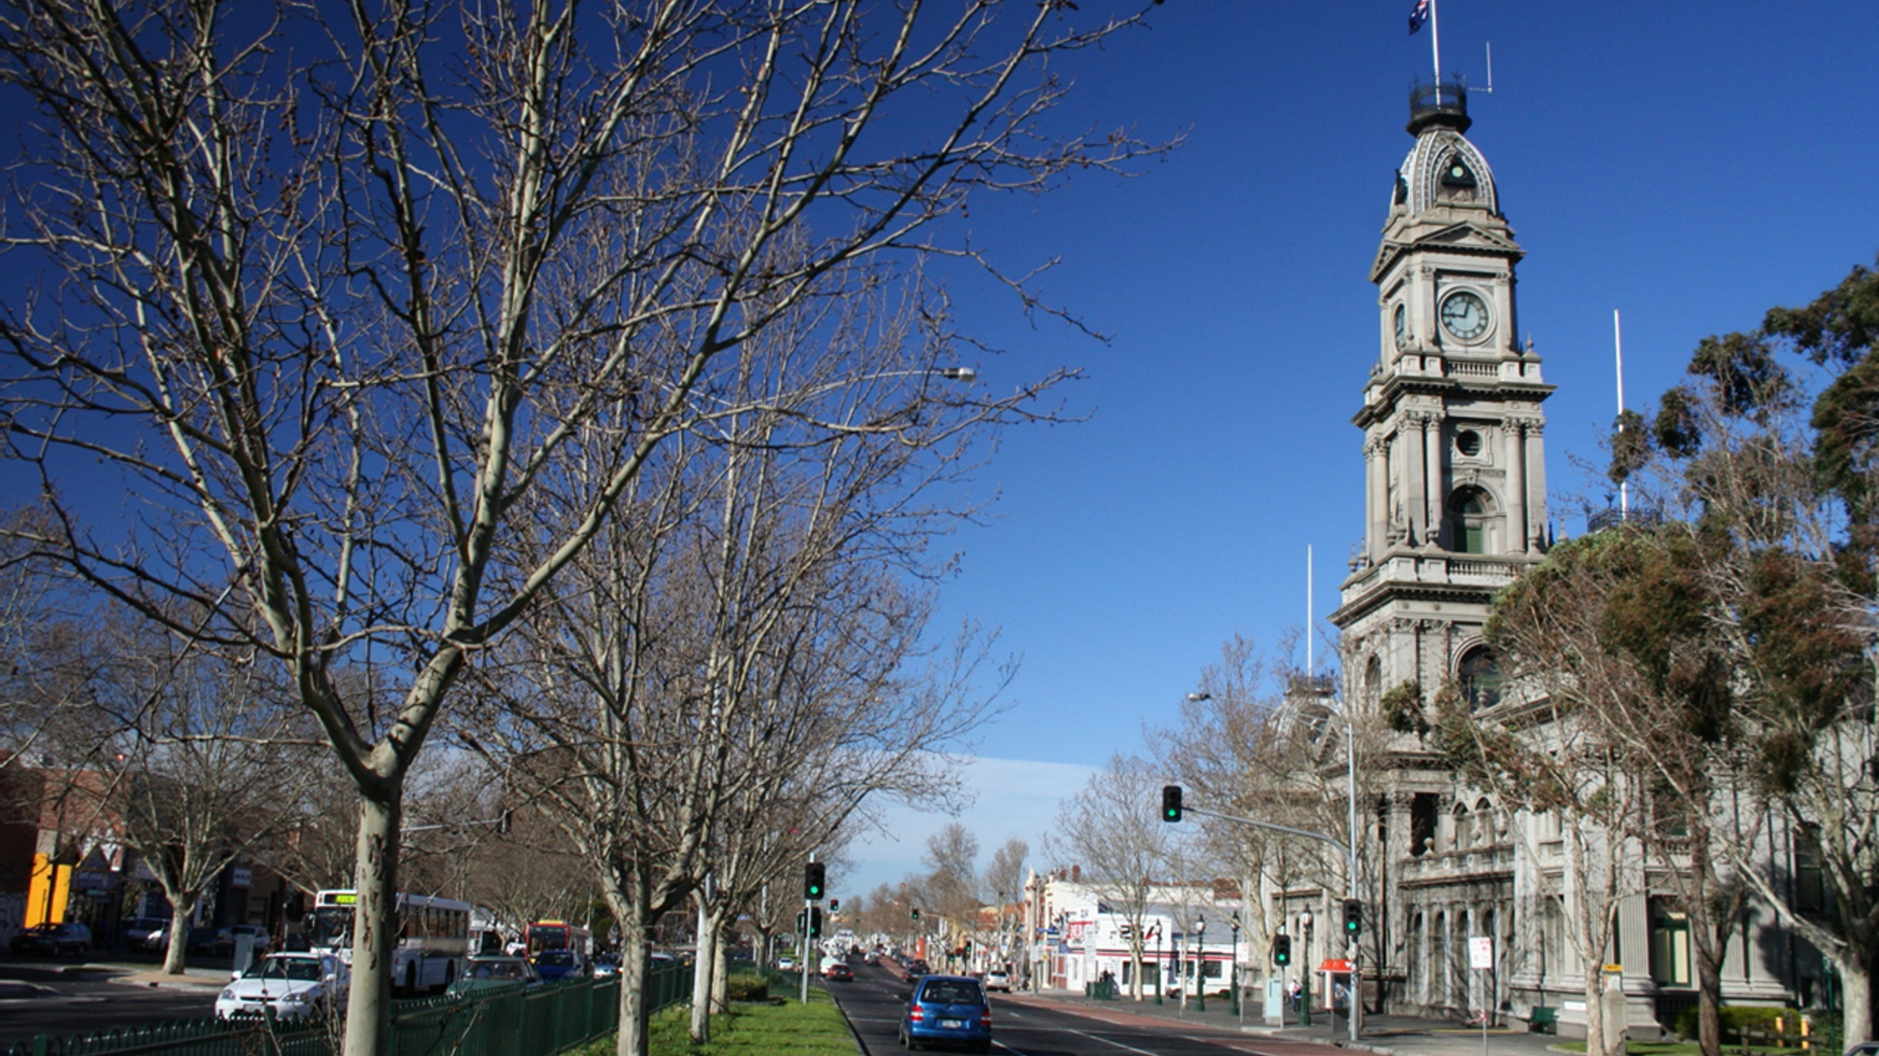
Collingwood Arts Centre Feasibility Study
Council Check-In
December 18, 2023

Slide 2
Land Acknowledgement
Colliers Project Leaders has offices across Canada. We acknowledge that our work takes place within ancestral, traditional, treaty and unceded territories, which continue to be home to many First Nations, Inuit and Métis people.
We continue to benefit from our presence on these lands and are committed to Reconciliation.

Slide 3
Agenda
01 | Project Overview
02 | Public Engagement Summary
03 | Preliminary Site Analysis
04 | Questions
05 | Next Steps |  | 04 | Next Steps

Slide 4
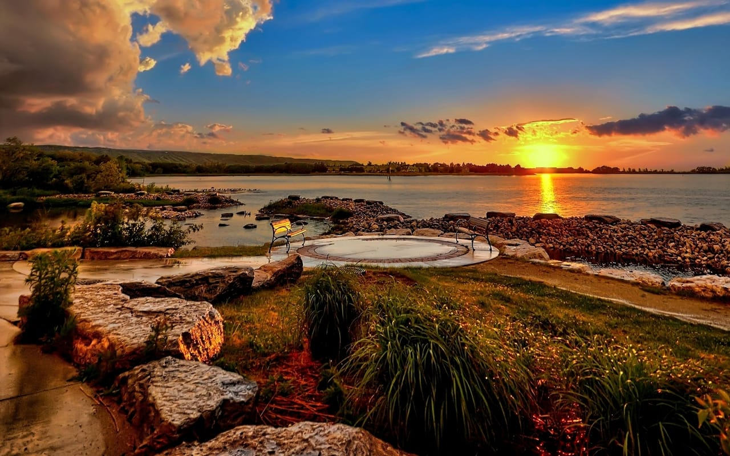
Project Overview
Section 1

Slide 5
Scope
Scope
Timeline
Project Overview
Concept Design
400 & 600 Seat Theatre Stacking Options
Site Plans, Floor Plans, Massing Illustrations
Costing
Class D Estimates
O&M Costs
Public Consultation
Preliminary Public Session
Findings Consultation
Fundraising Framework and Viability Assessment
Business Case
Plan: Approach, Milestones, Sources
Preliminary Consultations with Funders
Options and Assessment Criteria
Options Analysis
Site Selection
Final Option
Recommendations

Slide 6
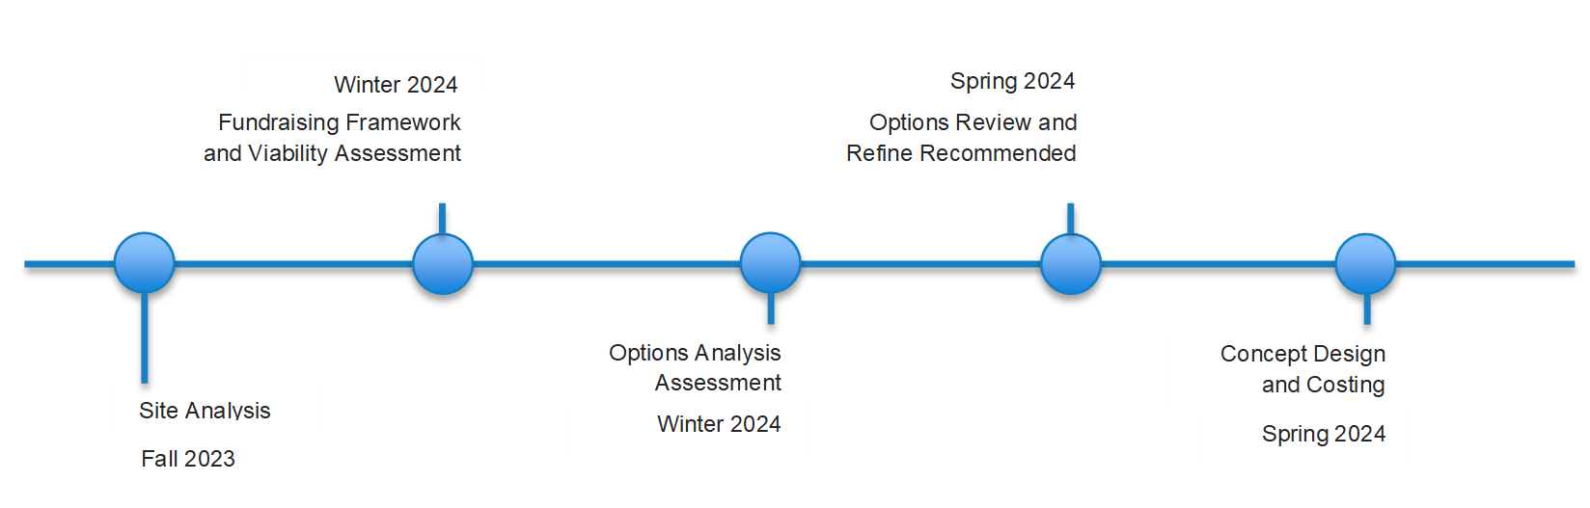
Timeline
Scope
Timeline
Project Initiation

Slide 7
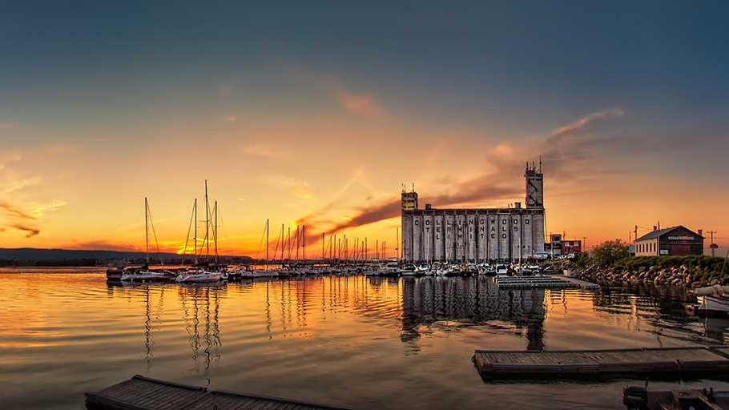
Public Engagement Summary
Section 2

Slide 8
Vision?
Public Feedback:
Scope?
Public Feedback:
Future Impacts?
Public Feedback:
Parking
Environmental stewardship
A place to foster and appreciate the arts
A place for the development of the arts (education)
A place to reflect surrounding cultural heritage
Conference spaces
Front-of-house tourism space
Storage (sets)
Shops spaces
Visual arts gallery
Performer residence
Theatre-sized rehearsal spaces
Financial costs
Operations
A place to “create”
Exhibition space
Tourism and economic development

Slide 9
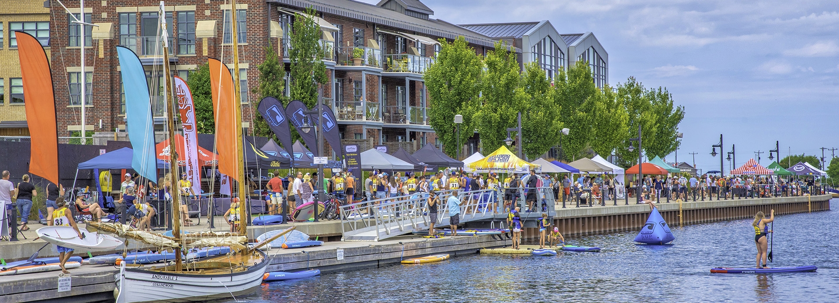
Preliminary Site Analysis
Section 3

Slide 10
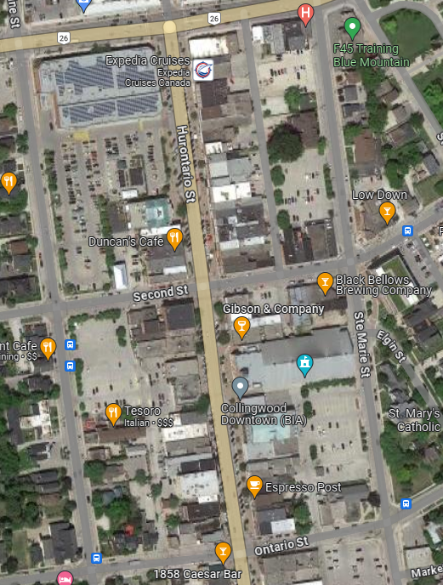
48 Ste
Marie St
101 Pine St
140 Ste Marie St

Slide 11
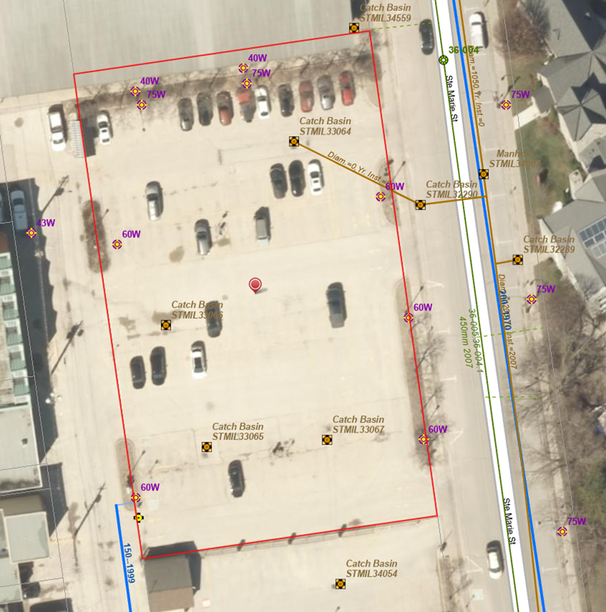
140 Ste Marie Street
Sites Summary
Area: ~35,260 SF
Floor Area Ratio: 1.27
Parking Bays: 79
Parking Ratio: 2.24
Pros Include:
Cons Include:
Potential to use the arena power
Lot is between publicly owned laneways
Lot is close to amenities
Lot doubles as parking for the Eddie Bush Arena
May need to connect 150 mm to 200 mm watermain
Electric vehicle charging stations were recently installed
Notes:
Falls on East and Crosstown transit routes

Slide 12
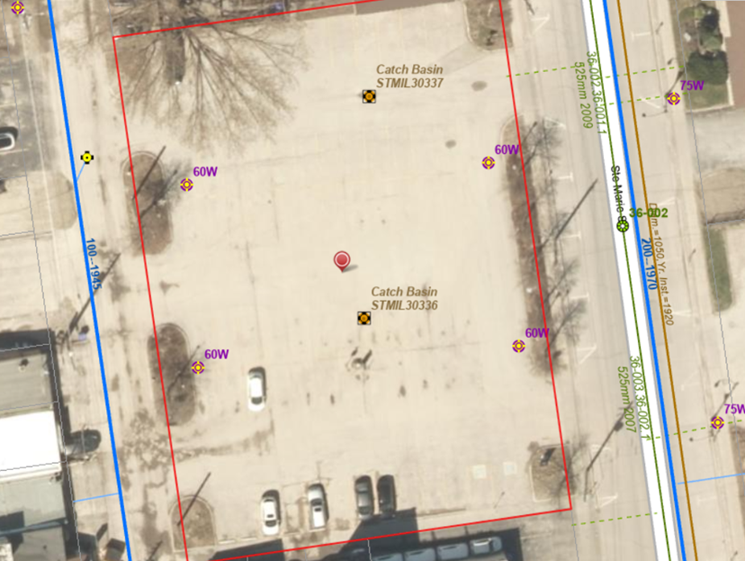
48 Ste Marie Street
Sites Summary
Area: 35,000 SF
Floor Area Ratio: 1.28
Parking Bays: 74
Parking Ratio: 2.11
Pros Include:
Cons Include:
Least likely to disrupt downtown
Has public pathways surrounding lot
Lot is used less than other two options
New 150 mm watermain required
$10M for new garage
Not as central
Notes:
Falls on East and crosstown transit routes

Slide 13
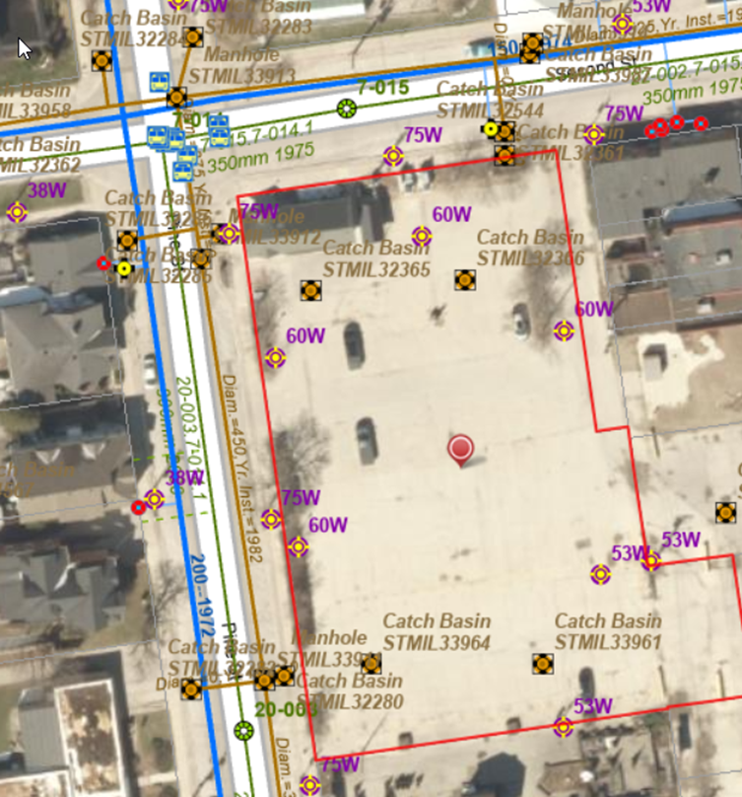
101 Pine Street
Sites Summary
Area: ~45,000 SF
Floor Area Ratio: 1.25
Parking Bays: 93
Parking Ratio: 2.59
Pros Include:
Cons Include:
Close to amenities
Largest of the three and
Lot is used less than the arena lot
Surrounded by privately-owned laneways
Location of Farmers Market in Summer
Electric parking stations installed recently
Transit building on property

Slide 14
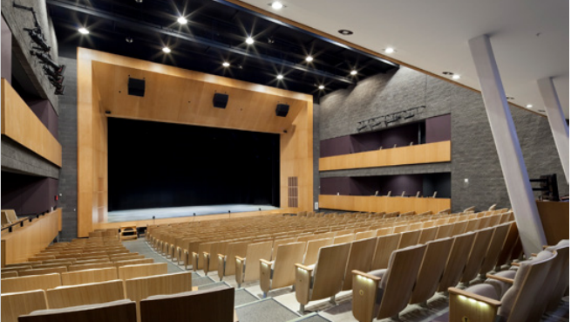
Next Steps
Section 4

Slide 15
Next Steps
Funding Framework and Viability Assessment
Costing and Financial Modelling
Site Analysis

Slide 16
Questions
Section 5

